Slide 1
Fall Progress Report
CS 461: Capstone Project
Group 39
Henry Fowler, Kailyn Hellwege, Taylor Kirkpatrick
Notes:
Introduce ourselves

Slide 2
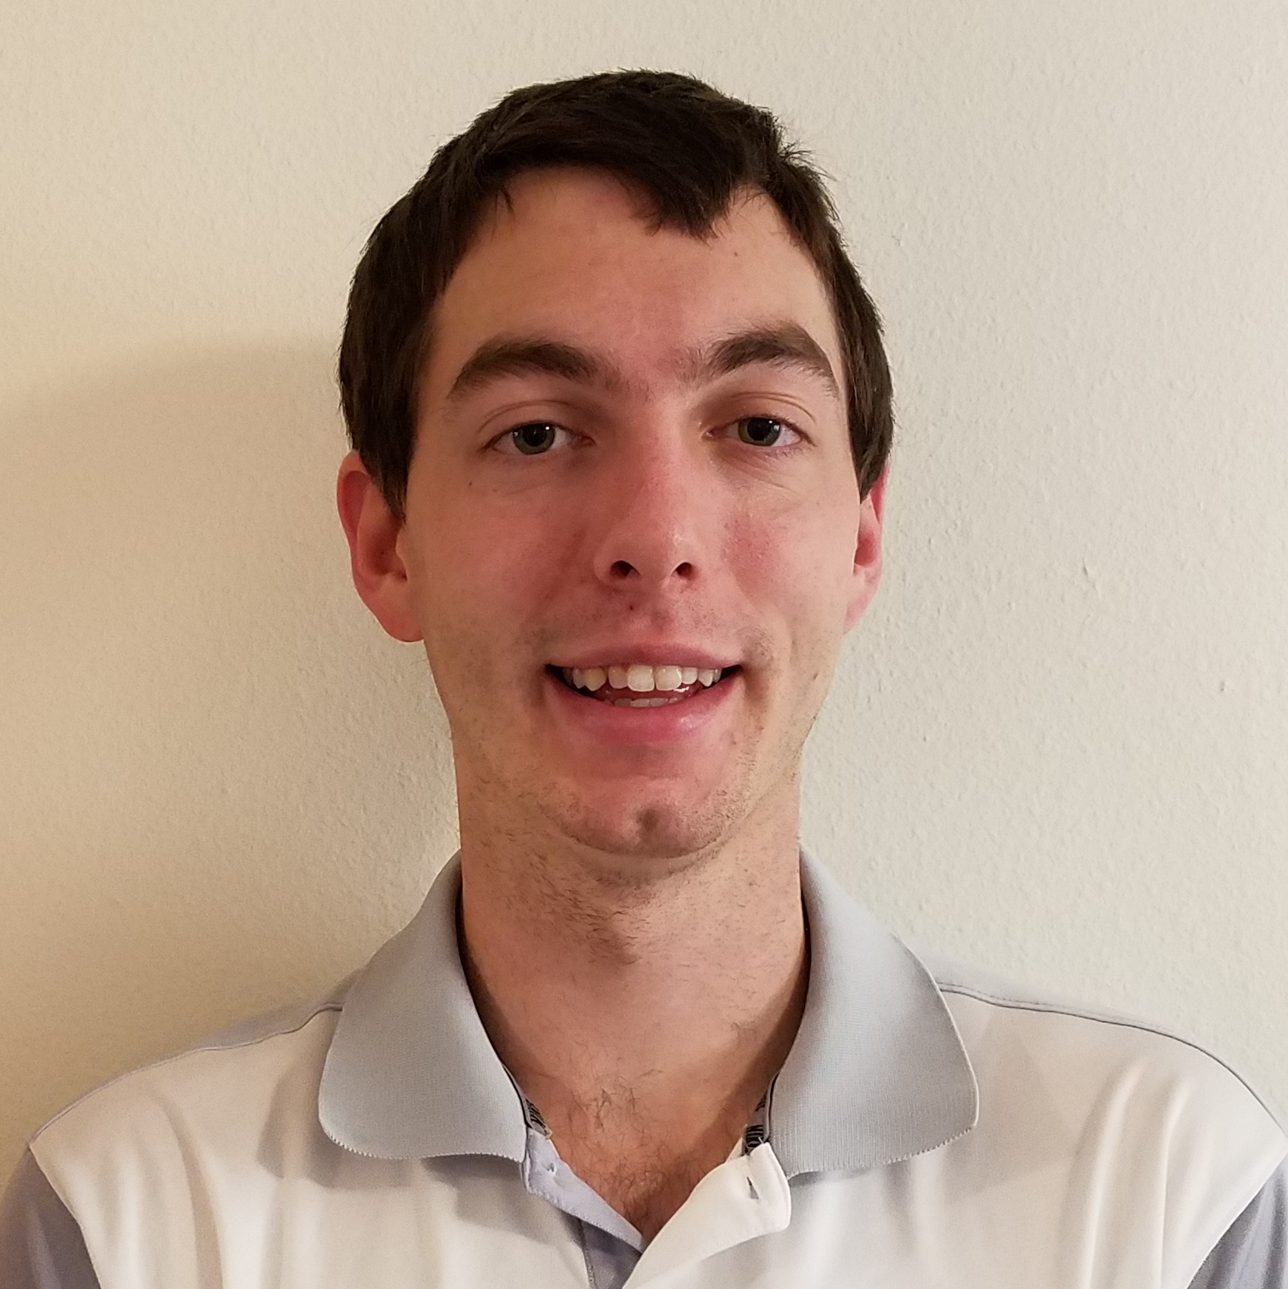
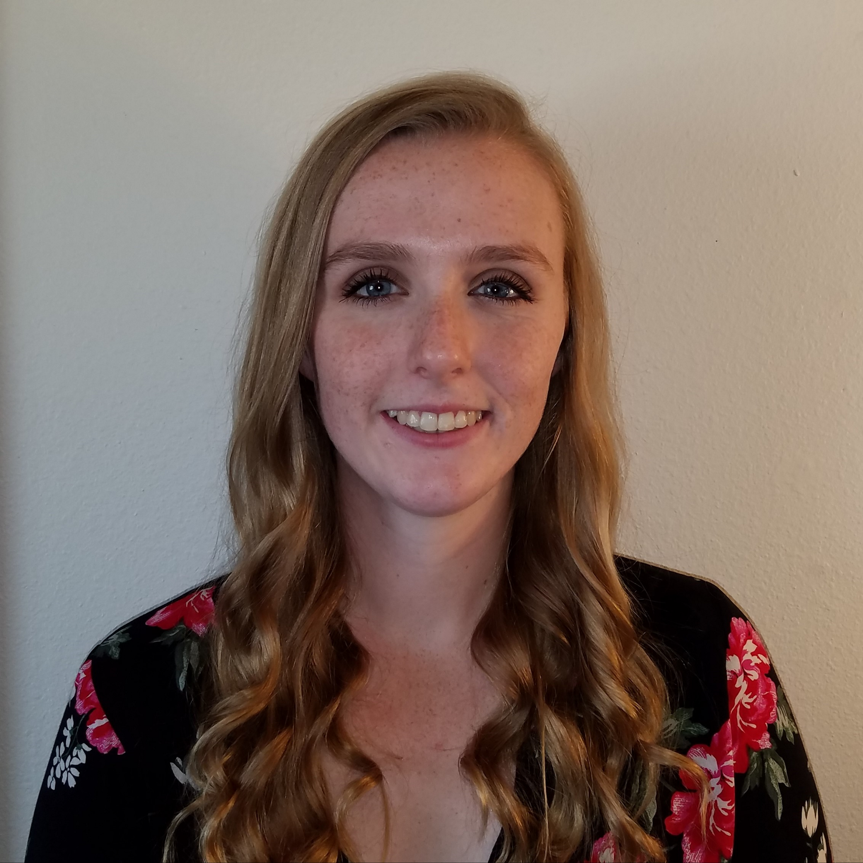

Development Team
Henry Fowler
Physical Server
Web Server
Database
Kailyn Hellwege
Content Delivery Network
Web Development Framework
Design Pattern
Taylor Kirkpatrick
Notification Framework
User Profile Framework
Issue Tracker Framework
Notes:
Introduce ourselves AGAIN! Mention that we’ll cover the specific features later

Slide 3
Client and Contacts
Dr. Chinweike Eseonu
Assistant Professor at the School of Mechanical, Industrial and Manufacturing Engineering
Kelly Warner
Process Improvement Manager at the College of Veterinary Medicine
Notes:
Have we talked to anyone else?

Slide 4
ConnectBasket Overview
An internal system for message transfer and tracking
Site will be available from outside the hospital
Receptionists can create and enter a message
Messages can be sent to users or groups of users
Notes can be added to a message by anyone who receives it
Message audit trails/history can be viewed by anyone with the correct permissions
Messages can be marked with states like “closed,” “open,” etc.
Users will have profiles to select groups and provide email to receive notifications
Notes:
Verrry high level.

Slide 5
ConnectBasket Overview
Receptionist receives call and creates message
Message routed to one or more staff members
Notes added to message
Message closed and returned to receptionist

Slide 6
Fall Term
Resume
Biography
Project Preferences
Project Groups Assigned
Individual Problem Statement
Group Problem Statement

Slide 7
Fall Term
Requirements
Individual Technology Reviews
Design Document
Fall Progress Report?
Weekly Summaries
Weekly TA Meetings

Slide 8
Planned Features
Physical Server
Web Server
Database
Content Delivery Network
Web Development Framework
Design Pattern
Notification Framework
User Profiles
Issue Tracker Framework
Notes:
Brief the viewer that we’re going to cover specific features, and that we’ll be passing the mic around
We should put whoever can talk the least about their project first, so they also get time from the intro stuff. We can add more slides at the end to pad the timing of the last person too, but the middle one will need about 6 minutes on their own unless we pass the mic in the middle of the intro.

Slide 9
Content Delivery Network
CDN : a group of servers that are distributed geographically that work together to quickly deliver Internet content, such as images, videos, and HTML pages
Design Decision: Cloudflare
Reasons:
Easy to set up
Multiple price levels
Optimizes performance and security

Slide 10
Web Development Framework
Web Development Framework : tools and resources used by software developers to create and manage websites
Design Decision: AngularJS
Reasons:
Powerful framework for building quick and easy to use web applications
Simple and easy to use tools

Slide 11
Design Pattern
Design Decision: Model-View-
Controller
Reasons:
ConnectBasket can be split into these three components
Three members of development team
MVC : stands for Model-View-Controller
Model : data and how it is represented
View : makes the data displayable to the user in a useful way
Controller : interface between the Model and View components

Slide 12
Notification Framework
SMS was considered, but rejected
We cannot use a phone’s “push notifications” without a native app
Notifications will be sent via email to the user
Users will be required to log their email in ConnectBasket
Notes:
SMS was rejected because it cost money, was ugly, and email is easier to use
And we aren’t making one. Push notifications are technically possible through a browser, but it requires the mobile browser to be open, requires the site to be loaded, and requires different behavior per phone/browser. Not worth it.
Email is easy enough to send from a webserver, (mostly) free, and allows the user to control how they are alerted and what they are alerted for on their mobile phone using their email app.
Also an added benefit of alerting users on desktop that don’t have the site open, assuming they have email popups like many do.
Users will need to anyway though for password resets. They can register their personal one though, if they don’t have work email updating to their phone.

Slide 13
User Profiles
User profiles will be unique
Users can login from anywhere
ConnectBasket will support the usual user account features
Notes:
Duh
Users will be able to log in from outside the hospital. Because of this, information will be properly encrypted as it may be sensitive.
Usual account features being cookies, logging out, persistent sessions, password reset, captcha (if needed), failed login throttlling, and email verification

Slide 14
Issue Tracker Framework
Core feature of the project
Messages between users
Messages from users to groups
Users can pull messages from a group
Anyone involved with a message can watch activity
Messages can be forwarded to other users/groups
Messages can be assigned a status
Notes:
This is the feature that the users will see and interact with
Groups, which users can be members of, all get access to a message sent to it. Users can assign themselves a message or take ownership of it, to signal to other users in the group not to work on it.
For auditing and general updates, any user with permission or who has already interacted with a message should be able to view the message later on, no matter who it is currently working on it or what has been done to it (unless permissions were raised somehow)
Messages can be passed on to other recipients, after edits or comments.
Messages can be closed to signal they are finished, and can be open. Other statuses may include duplicate, blocked, or on hold. These will depend more on the hospital’s workflow.

Slide 15
Physical Server
Server : Our project will involve setting up a server to host our web application
Design Decision: Linux Ubuntu Server
Reasons:
Easy to set up
Well documented
Free

Slide 16
Web Server
Web Server Software : We will set up web server software on the server to run our web application
Design Decision: Apache HTTP
Reasons:
Easy to set up
Well documented
Free

Slide 17
Database
Database : We will be setting up a database for our project to hold the information we collect through our application
Design Decision: MySQL
Reasons:
Capable of doing everything we need
Free
Works well integrating with almost any application

Slide 18
Roadblocks
Office politics
Infrequent meetings with client
Scheduling conflicts
Remote communication within development team
Notes:
Office politics
This wasn’t really a problem, but we should have something that we can claim we’ll improve on
See above
One of us (that is, me) was remote all term. That’ll change in the winter.

Slide 19
Roadmap For Winter Term
Development will start with configuring the web server and database
Then the main features of the application will be implemented using AngularJS
Lastly we will add the messaging features and work with feedback we get from the client and users of our project

